Slide 1
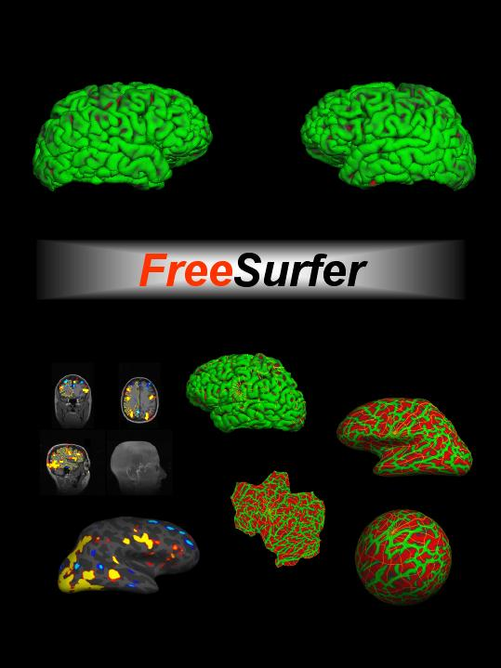


Surface-based Analysis:
Intersubject Registration and Smoothing

Slide 2
Outline
Motivation
Coordinate Systems
  3D (Volumetric)
  2D (Surface-based)
Intersubject registration
  Volume-based
  Surface-based
Surface-based smoothing
Surface-based clustering

Slide 3
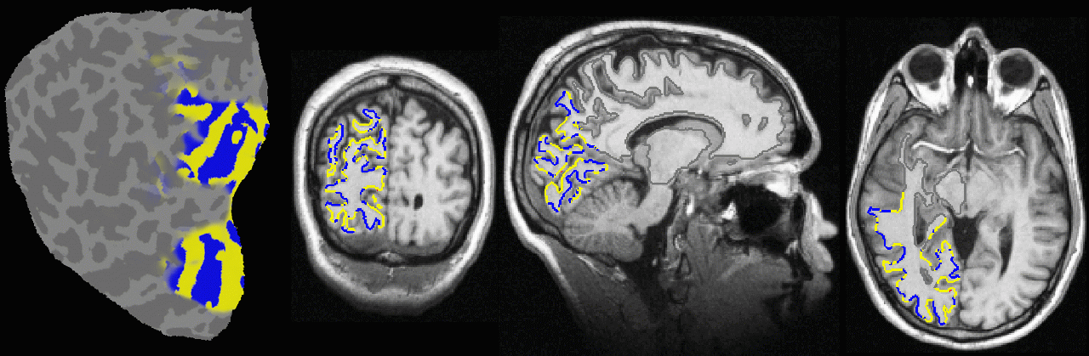
Why Is a Model of the Cortical Surface Useful?
Local functional organization of cortex is largely 2-dimensional! Eg, functional mapping of primary visual areas:
From (Sereno et al, 1995, Science).

Slide 4
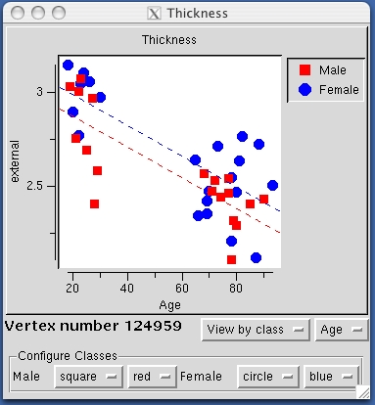
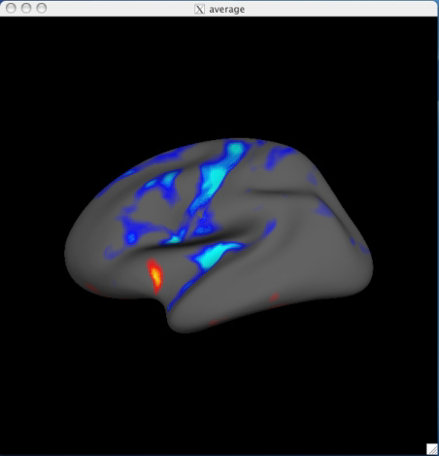
Surface-based Group Analysis (Thickness)

Slide 5
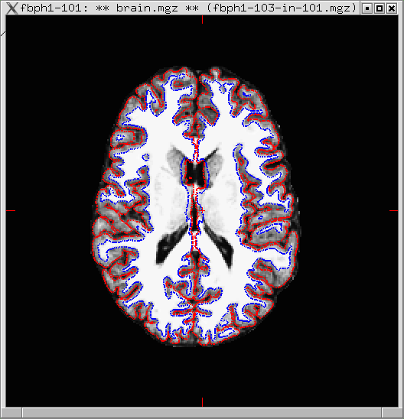
Coordinate Systems: 3D (Volumetric)
y
3D Coordinate System
  XYZ
  RAS (Right-Anterior-Superior)
  CRS (Column-Row-Slice)
  Origin (XYZ=0, eg, AC)
  MR Intensity at each XYZ
x
z

Slide 6
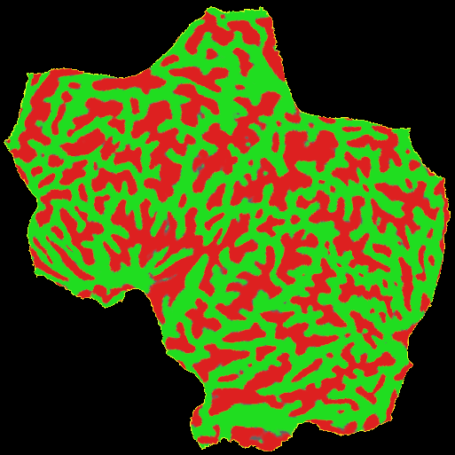
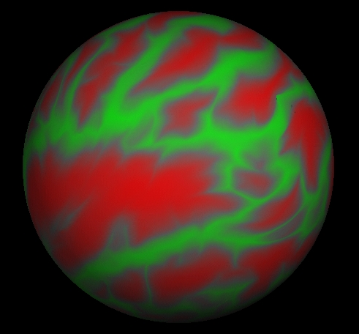
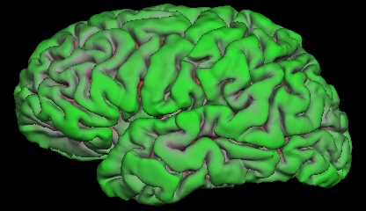
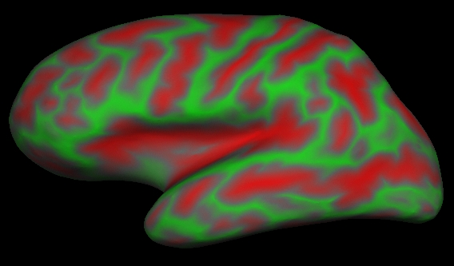
Coordinate Systems: 2D (Surface)
Sheet: 2D Coordinate System (X,Y)
Sphere: 2D Coordinate System
Latitude and Longitude (θ, φ)
Continuous, no cuts
Value at each point (eg, thickness)
y
central
anterior
x
posterior
sylvian
φ
superior temporal
calcarine
θ
Curvature
SULCUS (+)
GYRUS (-)
pial
inflated

Slide 7
Intersubject Registration

Slide 8
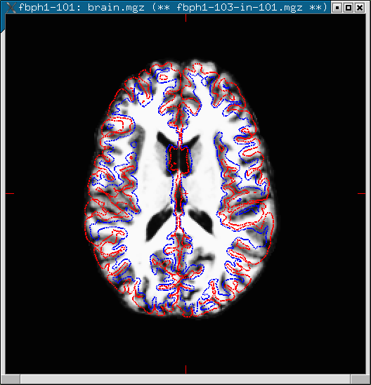
Volumetric Intersubject Registration
Affine/Linear
  Translate
  Rotate
  Stretch
  Shear
  (12 DOF)
Match Intensity, Voxel-by-Voxel
Problems
Can use nonlinear volumetric (cf CVS)

Slide 9
Surface-based Intersubject Registration
Subject 1
Subject 2
Curvature “Intensity”
SULCUS (+)
GYRUS (-)
Codes folding pattern
Translate, Rotate, Stretch, Shear (12 DOF)
Match Curvature, Vertex-by-Vertex
Nonlinear Stretching (“Morphing”) allowed (area regularization)
Actually done on sphere
“Spherical Morph”

Slide 10
Surface-based Intersubject Registration
  Gray Matter-to-Gray Matter (it’s all gray matter!)
  Gyrus-to-Gyrus and Sulcus-to-Sulcus
  Some minor folding patterns won’t line up
  Fully automated, no landmarking needed
  Atlas registration is probabilistic, most variable regions get less weight.
  Done automatically in recon-all

Slide 11
Spatial Smoothing
Why should you smooth?
Might Improve CNR
Improve intersubject registration (functional)
How much smoothing?
Blob-size
Typically 10-20 mm FWHM
Surface smoothing more forgiving than volume-based

Slide 12
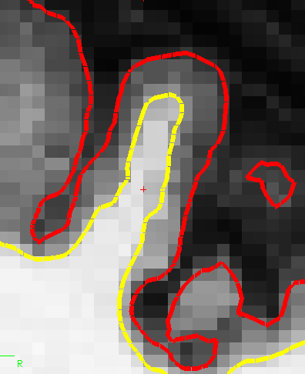
Volume-based Smoothing
14mm FWHM
  Smoothing is averaging of nearby voxels
7mm FWHM

Slide 13
Volume-based Smoothing
14mm FWHM
  5 mm apart in 3D
  25 mm apart on surface!
  Kernel much larger
  Averaging with other tissue types (WM, CSF)
  Averaging with other functional areas

Slide 14
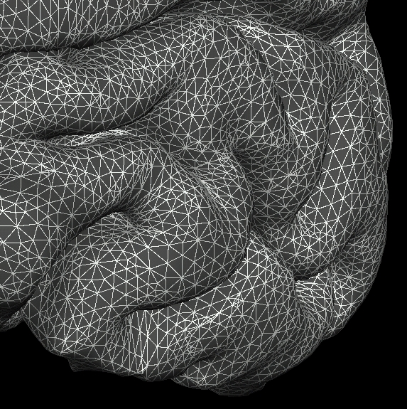
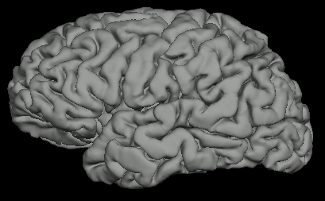
Surface-based Smoothing
  Smoothing is averaging of nearby vertices
Sheet: 2D Coordinate System (X,Y)
Sphere: 2D Coordinate System (θ,φ)
central
anterior
posterior
sylvian
superior temporal
calcarine

Slide 15
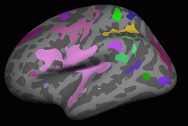
Surface-based Clustering
A cluster is a group of connected (neighboring) vertices above threshold
Neighborhood is 2D, not 3D
Cluster has a size (area in mm²)
Reduced search space (corrections for multiple comparisons)

Slide 16
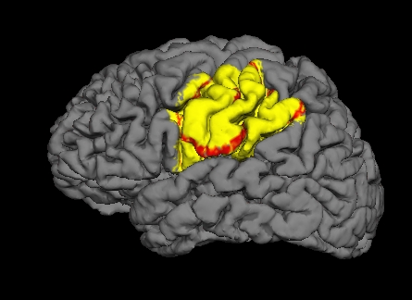
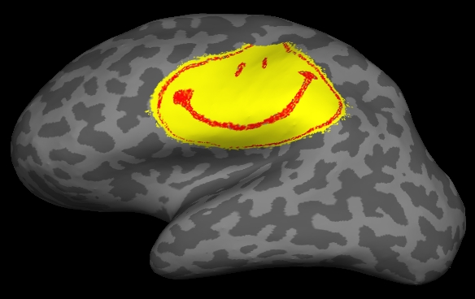
Summary
Why Surface-based Analysis?
  Function has surface-based organization
  Inter-subject registration: anatomy, not intensity
  Smoothing
  Clustering
  Like 3D, but 2D
Use FreeSurfer
Be Happy

